Slide 1

Getting Started

Slide 2
Agenda
Visual studio code features
Google chrome developer tools
Inspect document

Slide 3

Visual studio code features

Slide 4
HTML5 in Visual Studio Code
Visual Studio Code provides basic support for HTML5 programming out of the box.
There is syntax highlighting, smart completions with IntelliSense, and customizable formatting.
VS Code also includes great Emmet support.

Slide 5
Installation Steps
Visit the Visual Studio Code website to download the latest version of Visual Studio Code.
Windows users: This will download the latest version of Visual Studio Code as an .exe file.
Mac users: This will download the latest version of Visual Studio Code for Mac as a .zip file.
Linux users: .deb and .rpm are different file types for storing data. We suggest you download the .deb file so auto-updates work as the Visual Studio Code documentation suggests.

Slide 6
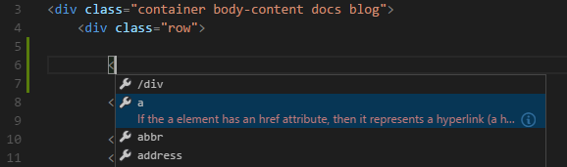
IntelliSense
As you type in HTML, it offer suggestions via HTML IntelliSense.
In the image below, you can see a suggested HTML element closure </div> as well as a context specific list of suggested elements.
It also offer up suggestions for elements, tags, some values (as defined in HTML5), Ionic and AngularJS tags.

Slide 7
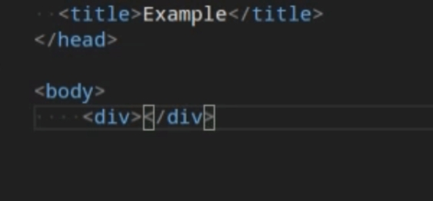
Close tags
Tag elements are automatically closed when > of the opening tag is typed.
The matching closing tag is inserted when / of the closing tag is entered.

Slide 8
Auto update tags
When modifying a tag, the linked editing feature automatically updates the matching closing tag.

Slide 9
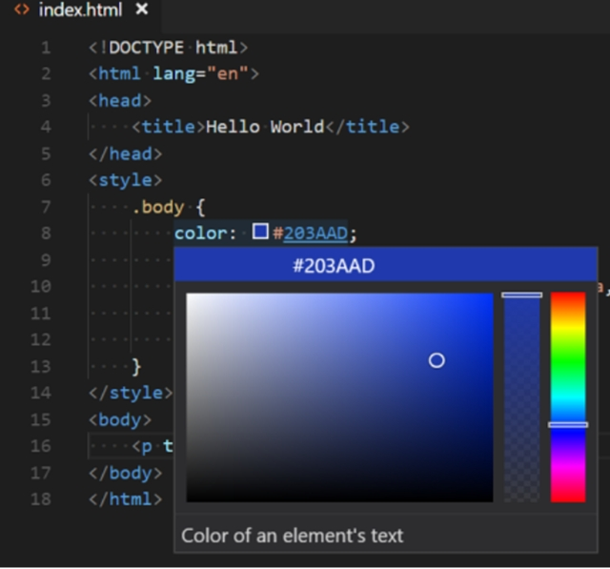
Code color picker
The VS Code color picker UI is now available in HTML style sections

Slide 10
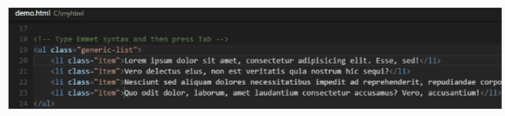
Emmet snippets
It support Emmet snippet expansion.
Emmet abbreviations are listed along with other suggestions and snippets in the editor auto-completion list.

Slide 11

Google chrome developer tools

Slide 12
Chrome DevTools
Chrome DevTools is a set of web developer tools built directly into the Google Chrome browser.
DevTools can help you edit pages on-the-fly and diagnose problems quickly, which ultimately helps you build better websites, faster.
When you want to work with the DOM or CSS, right-click an element on the page and select Inspect to jump into the Elements panel.
Or press Command+Option+C (Mac) or Control+Shift+C (Windows, Linux, Chrome OS).

Slide 13
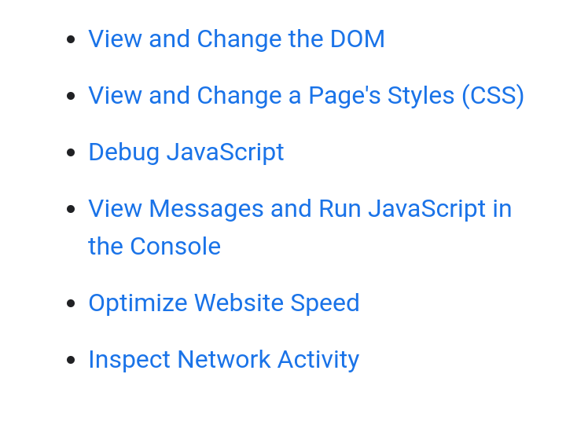
DevTools can improve your productivity

Slide 14
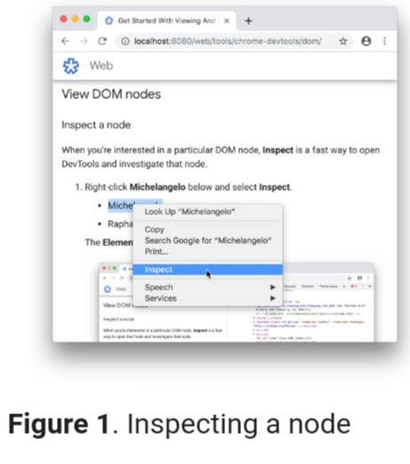
View DOM nodes
Inspect a node

Slide 15
Navigate the DOM Tree with a keyboard.
Scroll into view
Search for nodes
Edit the DOM
Edit attributes
Reorder DOM nodes
Hide a node

Slide 16

Inspect Documents

Slide 17
HTML Inspector
To use it, you can include the script in your pages during the development phase, then open your browser’s JavaScript console in the developer tools and run the command HTMLInspector.inspect().
This will display a number of warnings and recommendations right inside the console on how to improve your markup.
HTML Inspector also lets you change the configuration to customize the tool to your own needs.

Slide 18



